Slide 1
Magnet Falling Through Copper Pipe

Slide 2
Copper Pipe
Copper is NOT magnetic.
Copper (unlike iron or steel) will NOT be attracted to a magnet.
Copper is a very good conductor of electricity.
Experiment:
Materials: Copper pipe, permanent magnet, steel ball of same mass as magnet. Location: Near surface of the earth.
Release steel ball at top of pipe. It quickly falls to the ground with usual acceleration due to gravity.
Release magnet at top of pipe. It falls to the ground much more slowly than the steel ball did.
Why?

Slide 3
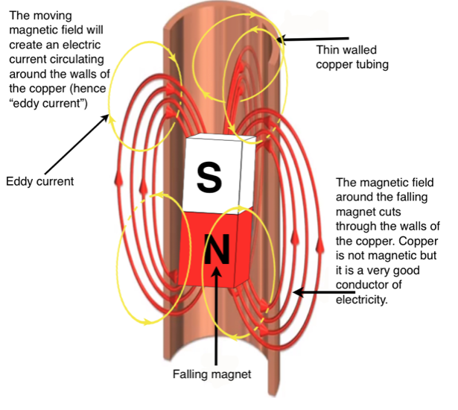

Slide 4
